Slide 2
Building Energy Communities: Strategies for Citizen Engagement
Thomas Mikkelsen, Smart Innovation Norway

Slide 3
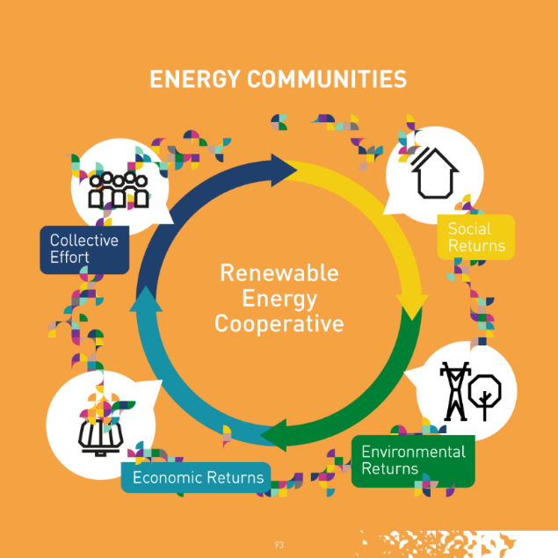
What do we want to achieve?
“
A successful energy community serves as a model for sustainable development, demonstrating how local action can contribute to broader energy transition goals while improving the quality of life for its members.

Slide 4

Preconditions
Regulatory and Legal Framework is clear
Technical assessment done
Physical location is settled
These things are equally important. But the building of the community is an often overseen part, left to develop after the economic assessment and the technical descriptions…

Slide 5
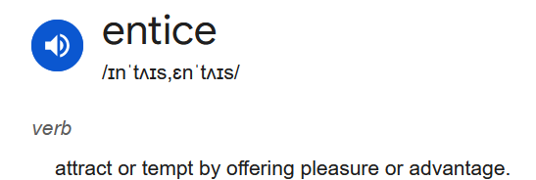
ENTICE – a strategy for energy community engagement
  E - Empowerment
  N - Neighbourhood
  T - Transparency
  I - Inclusivity
  C - Collaboration
  E - Evaluation

Slide 6

First step. Empowerment…
Empowerment is a fundamental element in building energy communities, fostering trust and credibility by equipping citizens with knowledge and resources.
This enables active participation and ownership, crucial for lasting engagement
A key for success is access to expert advice and independent support, as it allows communities to critically assess projects, enhancing transparency and confidence.
As a result, empowered community members become active contributors, transforming the project's foundation into a collaborative and sustainable success.

Slide 7

Establishing essence – The Neighbourhood
Neighbourhood plays a pivotal role in building energy communities by fostering a shared sense of belonging and collective identity among members.
It is critical to ensure that everyone feels part of the initiative, which requires actively involving all stakeholders in defining the scope and purpose of the community together.
This collaborative process strengthens trust, inclusivity, and ownership, creating a foundation for long-term engagement.
By emphasizing local connections and shared goals, the neighbourhood approach not only enhances social cohesion but also ensures that the energy community reflects the unique needs and aspirations of its members, making it both effective and resilient.

Slide 8

Implementation through transparency
Transparency is crucial during the implementation and building phase of energy communities, where rapid developments and unanswered questions can challenge trust.
Open communication about progress, decisions, and challenges ensures that community members remain informed and engaged, even in uncertain times.
By fostering transparency, project leaders demonstrate accountability and reinforce trust, preventing misunderstandings or skepticism from undermining the initiative.
Clear updates, accessible information, and honest dialogue create a resilient foundation for collaboration, ensuring that the community feels included and confident in the project's direction.

Slide 9

Overcoming the first hurdles through inclusivity
Inclusivity is paramount in the initial phase following the construction of renewable energy sources in energy communities. It ensures that all community members feel they are active participants in this new energy paradigm.
Inclusivity involves creating accessible platforms for engagement, addressing diverse needs, and providing support to overcome potential barriers to participation. This approach helps identify and address uncertainties or concerns that may arise as community members adapt to new ways of using and managing energy.
By fostering an inclusive environment, the energy community can better respond to varied perspectives, ensure equitable benefits, and cultivate a sense of shared ownership.
This inclusive foundation is essential for the long-term success and sustainability of the energy community, as it promotes widespread acceptance and enthusiastic participation in the new energy system.

Slide 10

Governance through collaboration
Collaboration is crucial in establishing a lasting governance model for energy communities, marking a pivotal moment in their development.
It involves diverse stakeholders co-creating decision-making structures, operational protocols, and benefit-sharing mechanisms.
This collaborative approach ensures that governance reflects the collective will of the community, fostering transparent processes and adaptive structures.
By building on shared responsibility and ownership, collaboration strengthens community bonds and enhances the legitimacy and sustainability of the energy community.

Slide 11

Making it last by measuring and evaluation
Evaluation serves a dual purpose in the final stage of establishing energy communities:
Post-implementation assessment: This comprehensive evaluation addresses lingering uncertainties and doubts, providing clarity on the community's performance and impact. It offers an opportunity to refine processes and address any remaining concerns among members.
Ongoing monitoring system: Evaluation also involves creating a robust framework for continuous data collection and analysis. This system, based on shared responsibilities, ensures the stability and optimal functioning of the community. It encompasses both technical aspects (e.g., energy production, consumption patterns) and human factors (e.g., member satisfaction, participation levels).
By institutionalizing evaluation, energy communities can maintain transparency, adapt to changing needs, and reinforce the lasting governance structure. This data-driven approach supports informed decision-making and helps sustain community engagement over the long term.

Slide 12
Summary

Slide 13

Six comprehensive steps
The ENTICE model provides a comprehensive framework for building and sustaining successful energy communities, guiding the process from initial planning through implementation and long-term operation:
Empowerment: Initiates the process by equipping citizens with knowledge and resources, establishing trust and credibility.
Neighbourhood: Defines the community's identity and scope, fostering a sense of belonging and shared purpose.
Transparency: Ensures open communication during the implementation phase, maintaining trust amidst rapid developments.
Inclusivity: Facilitates smooth transition to energy usage, addressing concerns and ensuring equitable participation.
Collaboration: Establishes lasting governance structures through stakeholder involvement and shared decision-making.
Evaluation: Assesses outcomes and implements ongoing monitoring, supporting long-term sustainability and adaptability.

Slide 14

Support actions?
Regulators and the state play a critical role in supporting energy communities throughout their lifecycle, but their involvement is most essential in specific phases of the ENTICE model:
1. Empowerment
The state can provide funding for expert advice and independent support systems to help communities critically assess projects and understand their feasibility. This ensures transparency and builds trust, particularly in the early stages of planning and engagement.
2. Transparency
During implementation, regulators should establish clear guidelines and communication frameworks to ensure that rapid developments do not undermine trust. They can mandate regular updates, accessible public consultations, and accountability mechanisms to keep citizens informed.
3. Collaboration
The state is pivotal in facilitating collaboration by creating enabling frameworks for governance models. This includes providing legal support, fostering partnerships among stakeholders, and ensuring equitable benefit-sharing mechanisms. Regulators can also incentivize participation through grants or tax benefits.
4. Evaluation
Regulators should support the establishment of robust monitoring systems that collect technical and human data to ensure the community’s stability and functionality over time. This includes funding for evaluation tools and ensuring compliance with national and EU standards.

